Slide 1


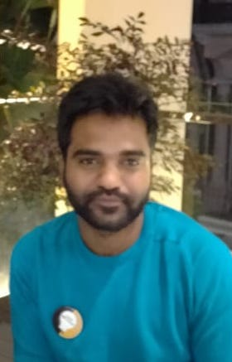

Timeseries
By satya
Git Hub : https://github.com/satyasatti/Time-series

Slide 2
Contents
About Timeseries
ARIMA
Time series with deep learning

Slide 3
Why Timeseries?
Why Time series?
Why we are using Timeseries?
Demand forecasting
Schedule staff in next month in call center
Build another power plant

Slide 4
Which one is time series?
Count of Cras Co2 Level

Slide 5




Time Series Components
01
Trend.
02
Seasonality
03
Cyclic
04
Irregularities

